Slide 1
Azure Partner Information Kit
Level 1: Cloud Control
techdata.com

Slide 2
Introduce the Info Kit
Cloud Partner Sales Information Kit Levels
Level 1
Cloud Control
Level 2
Cloud Adoption
Level 3
Cloud Strategic
Level 4
Cloud Business Outcomes
This sales enablement kit is designed for Tech Data Channel Partners to arm them with the knowledge and resources to support the sales process with the end-customer. In this info kit, we will focus on Level 1: Cloud Control for Azure and delve into the customer situation and the Tech Data capabilities, particularly around the StreamOne Enterprise Solutions Cloud Platform.

Slide 3
Why Azure Cloud Control with StreamOne Enterprise Solutions Cloud Platform?
StreamOne Enterprise Solutions (SES) Cloud Platform offers Tech Data’s ecosystem of channel partners and their customers self-service access to comprehensive solutions from leading cloud service providers. With interactive dashboards, analytics, and end-customer access and control, these capabilities enable you to expand your cloud business and help meet customers’ evolving cloud strategy needs.

Slide 4
Why Sell StreamOne Enterprise Solutions Cloud Platform? Addressing the Challenges of Uncontrolled IT.
1
Multiple Azure Accounts
2
Inability to Manage Cloud Spend
3
Lack Governance & Accountability

Slide 5
Why Sell StreamOne Enterprise Solutions Cloud Platform? Addressing the Challenges of Uncontrolled IT.
1
Customers end up managing multiple cloud accounts inefficiently, solving using SES for centralizing accounts into a consolidated billing model with dashboard visibility addresses a myriad of challenges including cloud sprawl and shadow IT.
Multiple Azure Subscriptions
2
Inability to Manage Cloud Spend
3
Lack Governance & Accountability

Slide 6
Why Sell StreamOne Enterprise Solutions Cloud Platform? Addressing the Challenges of Uncontrolled IT.
1
Customers end up managing multiple cloud accounts inefficiently, solving using SES for centralizing accounts into a consolidated billing model with dashboard visibility addresses a myriad of challenges including cloud sprawl and shadow IT.
Multiple Azure Subscriptions
2
Customers have no visibility into cloud spend across the organization, solving using SES makes it easier to improve oversight and control of departmental cloud spend along with automating department charge backs.
Inability to Manage Cloud Spend
3
Lack Governance & Accountability

Slide 7
Why Sell StreamOne Enterprise Solutions Cloud Platform? Addressing the Challenges of Uncontrolled IT.
1
Customers end up managing multiple cloud accounts inefficiently, solving using SES for centralizing accounts into a consolidated billing model with dashboard visibility addresses a myriad of challenges including cloud sprawl and shadow IT.
Multiple Azure Subscriptions
2
Customers have no visibility into cloud spend across the organization, solving using SES makes it easier to improve oversight and control of departmental cloud spend along with automating department charge backs.
Inability to Manage Cloud Spend
3
Customers have no consistent management processes for provisioning IaaS, solving using SES to centralize spend through a single portal with the ability to establish new account activation processes addresses accountability concerns and governance requirements.
Lack Governance & Accountability

Slide 8
What StreamOne can do for you beyond natural growth of customers’ Azure usage.
Why Sell StreamOne Enterprise Cloud Platform? Addressing the Challenges of Uncontrolled IT.
This platform sets us apart from our competition. Our customers can get the visibility and control they need to….
– Cloud Sales Manager, StreamOne Enterprise Solutions Cloud Platform Early Adopter
7%
10%
30%
Support Margin Enhancement with Azure Business-Level Support
Expected percentage point increase with value-added, managed services attach rate.
Anticipated percentage point increase in deployment, migration and education, services revenue.

Slide 9
Prescribing the Solution to Address Customer Uncontrolled IT Challenges
By bringing together StreamOne Enterprise Solutions Cloud Platform value-added Cloud Services and Education Services , Tech Data is your single source for addressing your customers’ Azure cloud control needs.

Slide 10
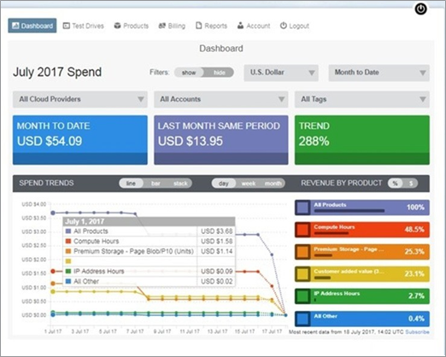
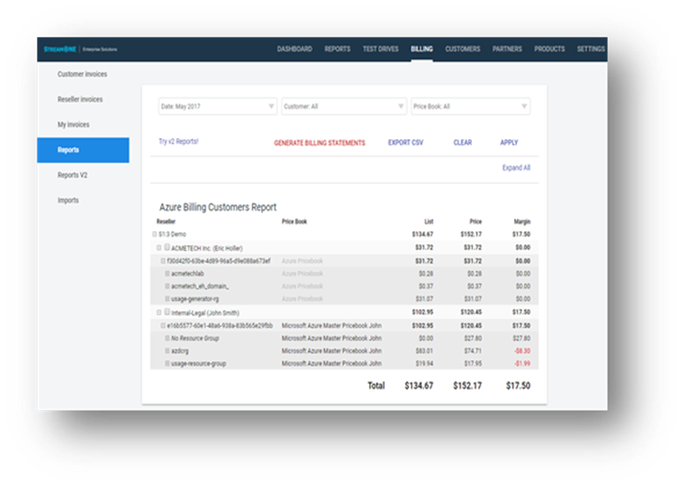
The Solution: StreamOne Enterprise Solutions Cloud Platform
StreamOne uniquely provides channel partners and their customers the ability to manage industry-leading cloud infrastructure services for greater efficiency with dashboards, analytics, and end-customer access and control.
Centralizes accounts into consolidated billing model
Reduce account sprawl
Take advantage of compute and storage volume tiers
Accurately maps charge-back costs
Improve oversight/control of departmental spend
Accurately assign and manage charge-back costs
Provides granular reporting for departmental level visibility
Streamlines management
Built-in approval based workflows with customizable templates
Easy migrate existing subscriptions and link new accounts
Department level self-service portal for new subscription requests

Slide 11
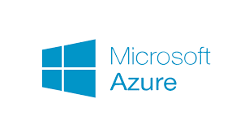
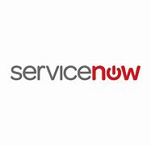
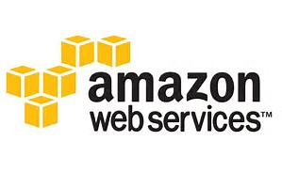
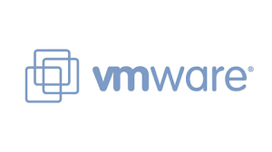
Build Your Revenue and Profit by adding Cloud Services to provide a more comprehensive customer solution
Assess
Migrate
Optimize
Manage
Instant portfolio expansion
Cloud Planning and Strategy Workshops
App migrations to, from and within public (AWS/Azure), private, hybrid cloud
Cloud Design & Implementations
Flexible support models
Access to expertise and tools
Workload Placement and Vendor-Specific (AWS & Azure) Assessments
Old Database to New Database Migration
Single portal service includes Service Desk, Support and Maintenance
Automation services to build & deploy private/hybrid cloud infrastructure
White label option for partners
Next generation data center transformation
Source Data to Target Data Migration, Translation and Archival
Integration services to/from ITSM, ITOM, and Automation platforms
Manage assets deployed across public and private cloud environments
Enhance “trusted advisor” status with customers
Grow margins
VMware optimization and upgrade assessments
Microsoft Azure EA/PAYG to CSP
VMware Implementations
End-to-end across apps, middleware and databases
A description of the Tech Data Cloud & Automation Services with length of engagement and fees are included in the kit.

Slide 12
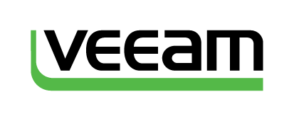
Build Your Revenue and Profit by adding Azure Education Services to provide a more comprehensive customer solution
Official Vendor Training for the top technologies and brands via flexible delivery offerings combining instructor-led and self-paced options
Instructors with real world experience
Internal capabilities supplemented by network of training partners worldwide
Public and Private classroom training in more than 80 countries
Notes:
Exit Certified

Slide 13
Information to Explore with Your Customers
 | Symptom | Problem | How StreamOne Can Help
Do you want to save money on your Azure spend? | Account sprawl with inefficient consumption of Azure services leading to over spending. | Multiple Azure accounts some created outside of IT called shadow IT and no ability to consolidate usage. | Centralize accounts into consolidated billing model using SES cloud platform to gain full visibility and control of cloud usage through out the organization.
Do you have visibility and the detailed reporting across the organization to manage cloud spend? Are you able quickly and accurately manage charge-backs? | No visibility across the organization leads to unorganized spending and tracking. | Lack a single platform to organize Azure spend to understand usage across the organization | SES provides self-service dashboards with n-tier drill-down views, and detailed reporting to monitor all associated cloud services usage and track all actual (not estimated) usage charges across every major product category.
 | A manual process with no ability to accurately assign and manage charge-backs. | No department level reporting; No department level views. | Organize and track costs by product category and defined cost centers to improve accuracy with assignment and management of charge-back costs.
How do you govern purchasing and provisioning of Azure across the organization? | Anyone with a credit card in the organization can purchase Azure services across the organization? | Lack a single portal with the ability to grant access for provisioning Azure services. Does not have visibility by account owner to see who is purchasing Azure. | Access built-in approval based workflows and extend admin rights to the SES self-service portal for provisioning new subscriptions. Also, gain the visibility needed at various levels within your organization for greater oversight.
Do you have the skilled staff to assess, migrate and manage you Azure environment? | Struggling with enough skilled staff to assess apps and migrate to Azure environment as well as optimize and manage your cloud environment. | Unable to advance business initiatives and fully benefit from cloud computing due to limited resources focused on managing current environment. | Access Tech Data’s full life cycle of cloud services to support and enhance your teams abilities to fully embrace cloud. Includes assessment, migration, optimization and managed services as well as training and education.
Notes:
Solutions selling starts with understanding the customer’s current situation and uncovering their challenges. It’s important for you to demonstrate knowledge and start to build credibility or trust with the customer. This chart is a quick reference guide of the common symptoms, problems and solutions for address AWS account control, security and optimization. You’ll see there is linked information to further define terminology and help grow your knowledge.

Slide 14
Terminology to Know
Cloud Sprawl
The uncontrolled proliferation of an organization’s cloud instances or cloud presence. It happens when an organization inadequately controls, monitors and manages its different cloud instances, resulting in numerous individual cloud instances which may then be forgotten but continue to use up resources or incur costs since most organizations pay for public cloud services.
Shadow IT
Tech-related activities that happen outside the scope of traditional IT. According to research most enterprises experience some level of unauthorized provisioning of cloud services—Shadow IT and many executives don’t know how many Shadow IT applications are being used within their organization.
Consolidated Billing and N-Tier Models
A Consolidated billing model brings all current Azure subscriptions together into one PO-based bill instead of multiple credit card bills. While multi-tier (or N-tier) enables customers to look at billing/usage at different levels within the organization such as by department, business unit and region for tracking and charge back purposes. SES provides the best of both billing models – Consolidated and N-tier.

Slide 15
How to Handle Objections to SES
Objection | Response
We do have multiple Azure subscriptions but still don’t see a need for a platform. | So you’ve been able to reduce account sprawl. What about easily controlling spend, automating chargebacks and creating governance? With our platform and self-service portal you are able to: Gain better oversight/control of spend with permission-based new account requests/activations Accurately assign/manage charge-backs Granular reporting for departmental level visibility Easy migrate existing and link new accounts Department level self-service portal for provisioning requests
I don’t want to learn a new platform and get locked in to a platform. | Unlike other cloud platforms that lack a direct connection to the cloud provider, with SES you are able to: Retain full control of your accounts and all dashboard information Access to all cloud provider services along with their unique features Discontinue use of StreamOne Enterprise Solutions without service impact

Slide 16
Moving Your Customers to StreamOne Enterprise Solutions (SES) Cloud Platform
Migrating new/existing Azure accounts in six easy steps:
(Step-by-Step Guide is included in Kit)
Step 1: Create Customer Account
Option 1. Resellers create the customer account using the reseller portal access
Option 2. Customers request an account through the reseller end-customer portal using the Signup feature. (Recommended)
Step 2: Add a Customer
1. From the StreamOne Enterprise Solutions (SES) Home screen, select the Customer module
2. In the Client section: add customer’s company information
Step 3: Before Creating a New CSP Azure subscription, associate a Tenant (or domain ID) to the SES Customer
Step 4: Create a New Tenant Identity - Go to Customer Module – Cloud Providers
Toggle to Azure and select CSP Customer Pricebook and under Microsoft Azure Identity ─ ‘Create new customer identity’ and complete all the required fields
Step 5: Add Linked Customer Account to Reseller
Send customer invitation to authorize Tech Data to be customer’s Microsoft Cloud Solution Provider.
Step 6: Send Request for an Azure CSP Subscription to the SES Cloud Support team for approval
When approved the subscription is provisioned and admin rights are provided to the customer

Slide 17
Sales Tools and Resources
Unless link is provided, access sales tools and resources
Battle Cards for
You to Prepare for Call
Marketing Materials
Sales Tools/ Marketing Resources
Azure Cloud Solutions
StreamOne Enterprise Solutions
Why Resell Training & Education Services
White-labeled “Manage and Control Azure Cloud Spend” Presentation
White-labeled StreamOne Enterprise Cloud Platform Datasheet
Move/Setup New Customer to SES Guide
Partner Azure POC Guide
Microsoft Partner Investment Request

Slide 18
enterprisecloudsales@techdata.com
Cloud Channel Newsroom
experiencetechdatacloud.com
@techdatacloud
Questions
About SES Cloud Platform?

