Slide 1
AWS Partner Information Kit
Level 1: Control, Secure and Optimize
techdata.com

Slide 2
Introduce the Info Kit
Cloud Partner Sales Information Kit Levels
Level 1
Cloud Control
Level 2
Cloud Adoption
Level 3
Cloud Strategic
Level 4
Cloud Business Outcomes
This sales enablement kit is design for Tech Data Channel Partners to arm them with the knowledge and resources to support the sales process with the end-customer. In this info kit, we will focus on Level 1: Cloud Control with AWS and delve into the customer situation and the Tech Data capabilities, particularly around the StreamOne Enterprise Solutions Cloud Platform.

Slide 3
Why AWS Cloud Control with StreamOne Enterprise Solutions Platform?
StreamOne Enterprise Solutions (SES) single platform offers Tech Data’s ecosystem of channel partners and their customers self-service access to comprehensive solutions from leading cloud service providers. With interactive dashboards, analytics, and end-customer access and control, these capabilities enable you to expand your cloud business and help meet customers’ evolving cloud strategy needs.

Slide 4
Why Sell StreamOne Enterprise Cloud Platform? Addressing the Challenges of Uncontrolled IT.
1
Multiple AWS Accounts
2
AWS Cloud Spend Not Optimized
3
Non-Compliant

Slide 5
Why Sell StreamOne Enterprise Solutions Cloud Platform? Addressing the Challenges of Uncontrolled IT.
1
Customers end up managing multiple cloud accounts inefficiently, solving for centralizing accounts into a consolidated billing model with dashboard visibility addresses a myriad of challenges from cloud sprawl and shadow IT to capturing volume tiered discounts and accurately assigning and managing charge-back costs across the organization.
Multiple AWS Accounts
2
AWS Cloud Spend Not Optimized
3
Non-Compliance

Slide 6
Why Sell StreamOne Enterprise Solutions Cloud Platform? Addressing the Challenges of Uncontrolled IT.
1
Customers end up managing multiple cloud accounts inefficiently, solving for centralizing accounts into a consolidated billing model with dashboard visibility addresses a myriad of challenges from cloud sprawl and shadow IT to capturing volume tiered discounts and accurately assigning and managing charge-back costs across the organization.
Multiple AWS Accounts
2
Customers not taking advantage of AWS Reserved Instances (RI) with no easy way to determine what to purchase, solving for optimized spend with detailed usage history and analytics reports that provide RI purchase recommendations to lower costs.
AWS Cloud Spend Not Optimized
3
Non-Compliance

Slide 7
Why Sell StreamOne Enterprise Solutions Cloud Platform? Addressing the Challenges of Uncontrolled IT.
1
Customers end up managing multiple cloud accounts inefficiently, solving for centralizing accounts into a consolidated billing model with dashboard visibility addresses a myriad of challenges from cloud sprawl and shadow IT to capturing volume tiered discounts and accurately assigning and managing charge-back costs across the organization.
Multiple AWS Accounts
2
Customers not taking advantage of AWS Reserved Instances (RI) with no easy way to determine what to purchase, solving for optimized spend with detailed usage history and analytics reports that provide RI purchase recommendations to lower costs.
AWS Cloud Spend Not Optimized
3
Customer not using security best practices, may have limited skilled staff and resources to effectively manage the AWS IT environment, solving for adopting security and compliance best practice by providing recommendations and possibly leveraging outside resources to manage the environment addresses non-compliance challengers.
Non-Compliance

Slide 8
What StreamOne can do for you beyond natural growth of customers’ AWS usage.
Why Sell StreamOne Enterprise Cloud Platform? Addressing the Challenges of Uncontrolled IT.
This platform sets us apart from our competition. Our customers can get the visibility and control they need to….
– Cloud Sales Manager, StreamOne Enterprise Solutions Cloud Platform Early Adopter
7%
10%
30%
Support Margin Enhancement with AWS Business-Level Support
Expected percentage point increase value-added, RI optimization, managed services attach rate.
Anticipated percentage point increase in deployment, migration and education, services revenue.

Slide 9
Prescribing the Solution to Address Customer Uncontrolled IT Challenges
By bringing together StreamOne Enterprise Solutions Cloud Platform and Value-Added Services, Tech Data is your single source for addressing your customers’ AWS control, security and optimization needs.

Slide 10
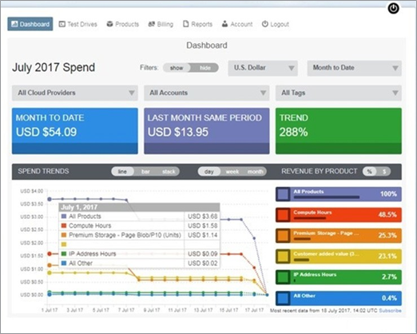
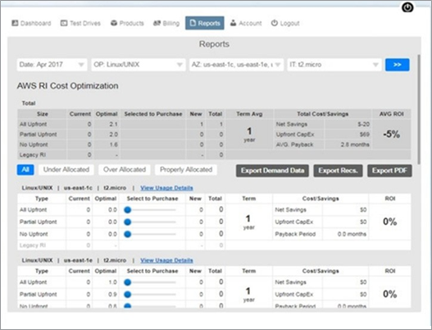
The Solution: StreamOne Enterprise Solutions Cloud Platform
StreamOne uniquely provides channel partners and their customers the ability to manage industry-leading cloud infrastructure services for greater efficiency with dashboards, analytics, and end-customer access and control.
Centralizes accounts into consolidated billing model
Reduce account sprawl
Take advantage of compute and storage volume tiers
Optimize costs through RI purchases with analytics/ recommendations
Accurately maps charge-back costs
Improve oversight/control of departmental spend
Accurately assign and manage charge-back costs
Provides granular reporting for departmental level visibility
Streamlines management
Built-in approval based workflows with customizable templates
Easy migration of existing and new accounts
Department level self-service portal for provisioning requests

Slide 11
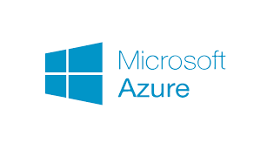
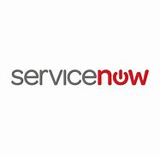
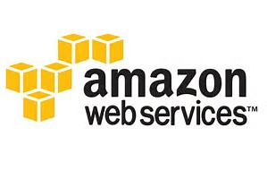
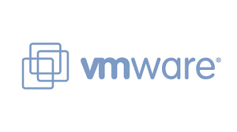
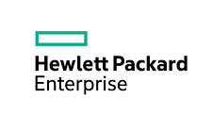
Build Your Revenue and Profit by adding Cloud Services to provide a more comprehensive customer solution
Assess
Migrate
Optimize
Manage
Instant portfolio expansion
Cloud Planning and Strategy Workshops
App migrations to, from and within public (AWS/Azure), private, hybrid cloud
Cloud Design & Implementations
Flexible support models
Access to expertise and tools
Workload Placement and Vendor-Specific (AWS & Azure) Assessments
Old Database to New Database Migration
Single portal service includes Service Desk, Support and Maintenance
Automation services to build & deploy private/hybrid cloud infrastructure
White label option for partners
Next generation data center transformation
Source Data to Target Data Migration, Translation and Archival
Integration services to/from ITSM, ITOM, and Automation platforms
Manage assets deployed across public and private cloud environments
Enhance “trusted advisor” status with customers
Grow margins
VMware optimization and upgrade assessments
Microsoft Azure EA/PAYG to CSP
VMware Implementations
End-to-end across apps, middleware and databases
A description of the Tech Data Cloud & Automation Services with length of engagement and fees are included in the kit.

Slide 12
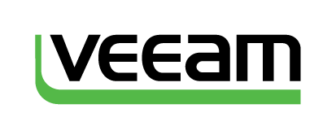
Build Your Revenue and Profit by adding AWS Education Services to provide a more comprehensive customer solution
Official Vendor Training for the top technologies and brands via flexible delivery offerings combining instructor-led and self-paced options
Instructors with real world experience
Internal capabilities supplemented by network of training partners worldwide
Public and Private classroom training in more than 80 countries
Notes:
Exit Certified

Slide 13
Information to Explore with Your Customers
 | Symptom | Problem | How StreamOne Can Help
Do you want to save money on your AWS spend? Are your AWS accounts consolidated for cost-effective control of your AWS spend? | Account sprawl with inefficient consumption of AWS services leading to over spending. | Multiple AWS accounts some created outside of IT called shadow IT and no ability to consolidate usage. | Centralize accounts into consolidated billing model using SES cloud platform to gain full visibility and control of cloud usage through out the organization.
 | Not getting the benefits of consolidating accounts. | Inability to aggregate AWS spend to benefit from tiered discounts and aggregated support costs. | Centralize accounts into consolidated billing model enables customers to take advantage of compute/storage volume tiers.
 | No visibility across the organization of cloud spend; Not able to accurately assign and manage charge-back costs. | Lack a single platform to manage cloud spend across the organization; No department level reporting; No department level views. | SES provides self-service dashboards with n-tier drill-down views, detailed usage and reporting to accurately assign and manage charge backs at any level across the organization.
Is your AWS cloud spend optimized with the purchase of Reserved Instances? | Not taking advantage of AWS Reserved Instances (RIs) today. | No easy way to determine RI purchases to optimize spend. | With our platform’s robust analytics reports customers are able to work from actual billing data (current and historical demand) to receive RI purchase recommendations that optimize cloud spend with greater accuracy.
 | Not sure if over or under purchasing RIs. | Lack the analytical tools and resources for ongoing RI optimization best practices. | Customers can utilize Tech Data AWS RI Optimization Managed Service to further optimizes RI usage efficiency with access to consultants and advanced tools.
Are you using security best practices to ensure your data is safe? | Compliance and security challenges; Not sure if using best practices. | Not using security best practices leaving data vulnerable. | Take advantage of SES robust analytics to improve security posture with recommendations on best practices to implement.
Do you have the skilled staff to manage you AWS environment? | Struggling with enough skilled staff to proactively manage cloud environment. | Unable to advance business initiatives due limited resources focused on managing cloud environment. | Access Tech Data’s training and education services to enhance your teams skills with AWS Operations, Architect and Developer courses. Also available is a managed service option to outsource the ongoing monitoring and management of AWS environment.
Notes:
Solutions selling starts with understanding the customer’s current situation and uncovering their challenges. It’s important for you to demonstrate knowledge and start to build credibility or trust with the customer. This chart is a quick reference guide of the common symptoms, problems and solutions for address AWS account control, security and optimization. You’ll see there is linked information to further define terminology and help grow your knowledge.

Slide 14
Terminology to Know
Cloud Sprawl
The uncontrolled proliferation of an organization’s cloud instances or cloud presence. It happens when an organization inadequately controls, monitors and manages its different cloud instances, resulting in numerous individual cloud instances which may then be forgotten but continue to use up resources or incur costs since most organizations pay for public cloud services.
Shadow IT
Tech-related activities that happen outside the scope of traditional IT. According to research most enterprises experience some level of unauthorized provisioning of cloud services—Shadow IT and many executives don’t know how many Shadow IT applications are being used within their organization.
AWS Reserved Instances
AWS Reserved Instances or RIs are a way for businesses to take advantage of a significant discount across a range of AWS services compared to On-Demand Instance pricing. The savings can be considerable---up to 75% compared with On-Demand instance pricing. While RIs help consumers lower overall cloud spend, it requires vigilant review as well as concentrated knowledge and tools to determine the optimal amount of compute consumption capacity.

Slide 15
How to Handle Objections to SES
Objection | Response
We do have multiple AWS accounts and the accounts are already consolidated so don’t see a need for a platform. | So you’ve be able to reduce account sprawl and take advantage of volume and support discount tiers. What about easily controlling spend and managing department chargebacks? With our platform and self-service portal you are able to: Gain better oversight/control of spend Accurately assign/manage charge-backs Granular reporting for departmental level visibility Easy migrate existing and link new accounts Department level self-service portal for provisioning requests
We do have multiple AWS accounts and the accounts are already consolidated so don’t see a need for a platform. | Even though your accounts are consolidated, are you taking advantage of AWS RIs to optimize your cloud spend. You’ll are able to benefit from our platform and its analytics that recommend RI purchasing. With our platform’s robust analytics reports you are able to work from actual billing data and both current and historical demand to receive RI purchase recommendations to optimize cloud spend with greater accuracy. Plus we do offer an AWS RI Managed Service so you can free up your staff and rely on our expert consultants and advanced tools to further your savings.
I don’t want to learn a new platform and get locked in to a platform. | Unlike other cloud platforms that lack a direct connection to the cloud provider, with SES you are able to: Retain full control of your accounts and all dashboard information Access to all cloud provider services along with their unique features Discontinue use of StreamOne Enterprise Solutions without service impact

Slide 16
How to Move Your Customers to StreamOne Enterprise Solutions Cloud Platform
Migrating existing AWS accounts in five easy steps:
Step 1: Create Customer Account
Option 1. Resellers create the customer account using the reseller portal access
Option 2. Customers can request an account through the reseller end-customer portal using the Signup feature. (Recommended)
Step 2: Add a Customer
1. From the StreamOne Enterprise Solutions (SES) Home screen, select the Customer module
2. In the Client section: add customer’s company information
Step 3: Create a Link Existing Accounts Request
Click Cloud Provider, i.e. AWS
Add Customer’s AWS Account # and add AWS Business Level Support
Step 4: Request is Sent to AWS on Behalf of Reseller by SES Support.
Step 5: AWS Sends the Invitation to Link to the Customer and Notifies Reseller.

Slide 17
Sales Tools and Resources
Access Sales Tools and Resources
Battle Cards for
You to Prepare for Call
Customer Presentations
Customer Collateral for You to Brand
Sales Tools/ Marketing Resources
AWS Cloud Solutions
StreamOne Enterprise Solutions
Why Resell Training & Education Services
Manage and Optimize Your AWS Cloud Spend
RI Optimization Managed Service
StreamOne Enterprise Cloud Platform
RI Optimization Managed Service
Move/Setup New Customer to SES Guide
MDF Program Request (Campaigns, Events) and POC (Test Drive) Program Request Form

Slide 18
enterprisecloudsales@techdata.com
Cloud Channel Newsroom
experiencetechdatacloud.com
@techdatacloud
Questions
About SES Cloud Platform?

