Slide 1
Cloud Control for Azure with StreamOne Enterprise Solutions Platform

Slide 2
Agenda Overview
General Azure Challenges
How We Can Help
Our Platform and Services
Next Steps

Slide 3
Fundamental IaaS Challenges
Multiple Azure accounts some created outside of IT and no ability to consolidate usage.
Inability to aggregate Azure spend to benefit from tiered usage and support discounts.
Lack a single platform to manage cloud spend across the organization.
Unable to advance business initiatives due to limited resources and skilled staff to full embrace cloud computing.

Slide 4
Why [Partner Name] Can Help You Gain Better Azure Cloud Control
We bring together StreamOne Enterprise Solutions Cloud Platform, value-added services and training resources to help address your Azure cost control and optimization needs. StreamOne Enterprise Solutions (SES) single platform offers you self-service access to comprehensive solutions from leading cloud service providers with interactive dashboards, analytics, and end-customer access and control.

Slide 5
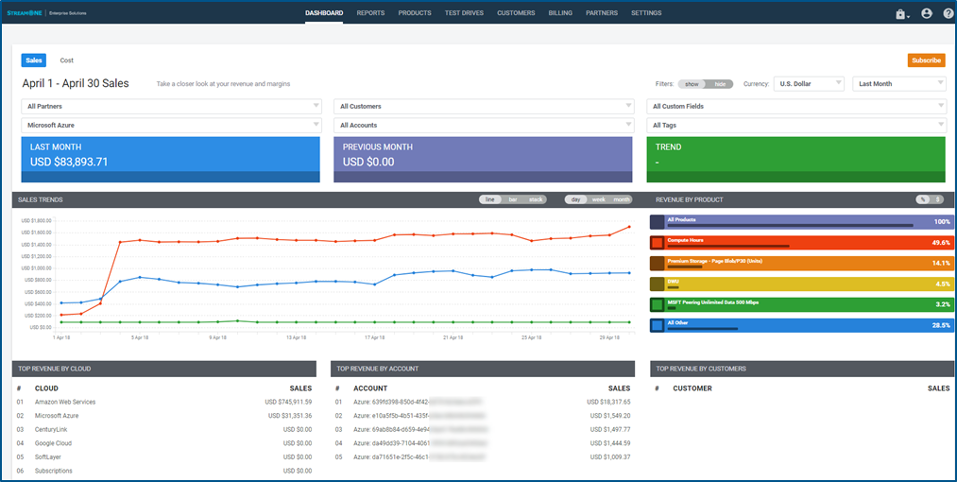
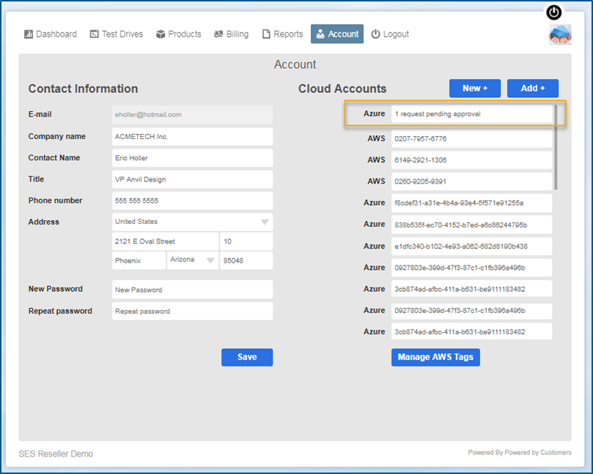
The Solution: StreamOne Enterprise Solutions Cloud Platform
StreamOne uniquely provides you with the ability to manage industry-leading cloud infrastructure services for greater efficiency with dashboards, analytics, and end-customer access and control.
Centralizes accounts into consolidated billing model
Reduce account sprawl
Take advantage of compute and storage volume tiers
Accurately maps charge-back costs
Improve oversight/control of departmental spend
Accurately assign and manage charge-back costs
Provides granular reporting for departmental level visibility
Streamlines management
Built-in approval based workflows with customizable templates
Easy migration of existing and new accounts
Department level self-service portal for provisioning requests

Slide 6
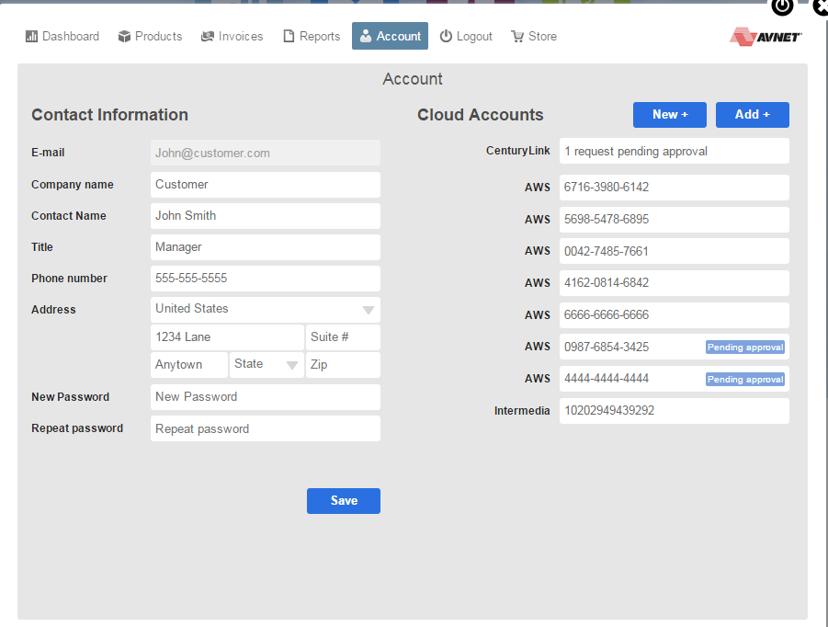
Centralize Spend and Create Governance
Single end-user admin to activate new accounts
Infinite number of accounts
Easy to link in active accounts
Easy to activate new Azure accounts
Creates consolidation of Azure bill to leverage support and volume clips
Need Azure Screen Shot

Slide 7
Possible Corporate Governance Policy Enhancements
One or more administrator(s)
All Azure accounts are activated by the administrator
Create process to request and activate new Azure accounts
Administrator retains Root Credentials; creates IAM roles for users in an account

Slide 8
Benefits With StreamOne Enterprise Solutions Platform
Before
After
Unorganized Azure spend and tracking
No visibility to understand usage and control spend across the organization
No ability to accurately chargeback department spend
Organized Azure spend with corporate governance policy
Improve oversight/ control of dept. spend
Gain visibility and accountability of cloud spend across the organization.
1. Centralize spend into a consolidated billing model and create governance to control costs
2. Proactively manage with self-service dashboard, reporting and analytics capabilities
3. Gain control of IaaS spend across multiple cloud providers leveraging a single platform

Slide 9
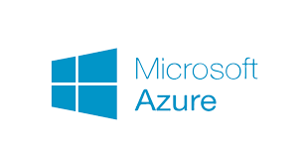
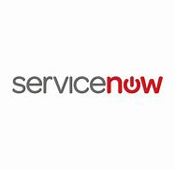
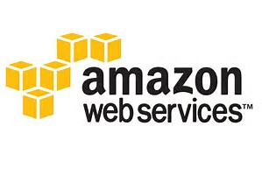
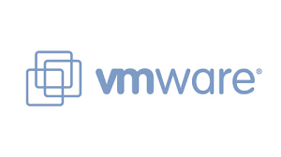
Cloud Services to Achieve Business Outcomes
Assess
Migrate
Optimize
Manage
Understand Business Readiness
Cloud Planning and Strategy Workshops
App migrations to, from and within public (AWS/Azure), private, hybrid cloud
Cloud Design & Implementations
Flexible support models
Gain Alignment of Business Goals
Workload Placement and Vendor-Specific (AWS & Azure) Assessments
Old Database to New Database Migration
Single portal service includes Service Desk, Support and Maintenance
Automation services to build & deploy private/hybrid cloud infrastructure
Reduce Complexity
Next generation data center transformation
Source Data to Target Data Migration, Translation and Archival
Integration services to/from ITSM, ITOM, and Automation platforms
Manage assets deployed across public and private cloud environments
Lower Risk
Speed Time to Results
VMware optimization and upgrade assessments
Microsoft Azure EA/PAYG to CSP
VMware Implementations
End-to-end across apps, middleware and databases

Slide 10
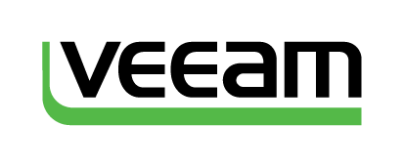
Up-skill Your Team with IT Training & Certification Courses
Official Vendor Training for the top technologies and brands via flexible delivery offerings combining instructor-led and self-paced options
Instructors with real world experience
Internal capabilities supplemented by network of training partners worldwide
Public and Private classroom training in more than 80 countries
Notes:
Exit Certified

Slide 11
Azure Training from ExitCertified
Whether you are new to Azure or a cloud professional looking to skill up across platforms, we offer courses teaching you everything from the fundamentals to implementation and how to architect Azure solutions. You’ll learn the skills needed to become an expert and certify on Microsoft Cloud Solutions.
Sample of Courses Available

Slide 12
Next Steps
StreamOne Enterprise Solutions Demo
Platform Proof of Concept
Services Discovery and Scoping

